Slide 1
Draw Boxes around Traffic Lights in an image.
Using Python, OpenCV &
Faster R-CNN

Slide 2
Approach to the Problem
Since the number of images in the dataset are very few so I have used annotation tool to get the bounding box coordinates. The tool I’ve used is LabelImg.
Using the LabelImg tool I’ve generated xml files for each images.
Now I have used Two ways to perform the given task.
Using Python code that will take the input as image and its xml code.
Using the Faster R-CNN Model (Not so accurate due to small dataset)
4. At last we get the images with labelled state of Traffic Light

Slide 3
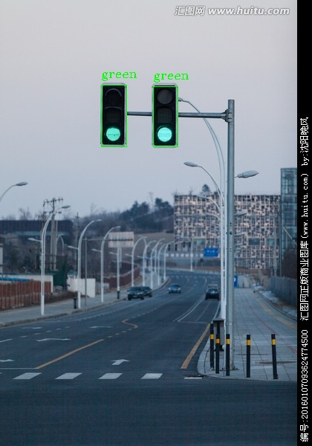
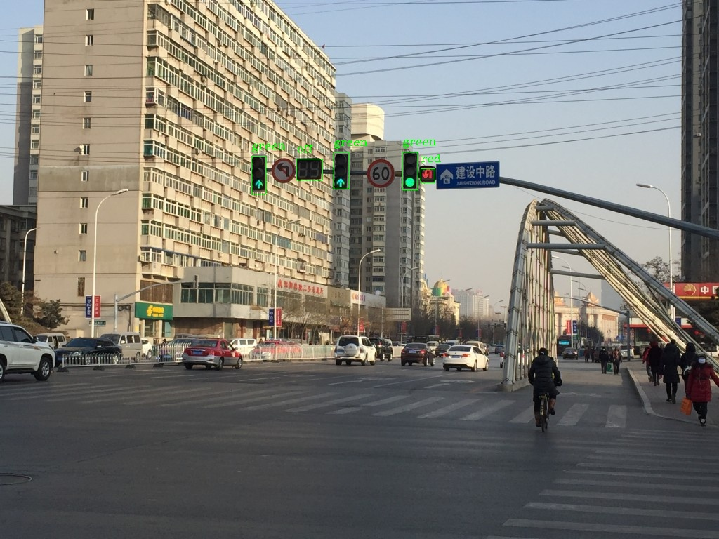
Some Output Generated

Slide 4
First Way to do the Task
Using Python and OpenCv

Slide 5
Step 1.
Using given Images and their respective xml files .I’ve extracted the state of traffic light and the coordinates of the rectangular box.
For extraction of data I’ve used following function in the code i.e,
extract_info() - Gives all the data into a list form.
chunks() - Divide the data into given by extract_info() into equal parts.

Slide 6
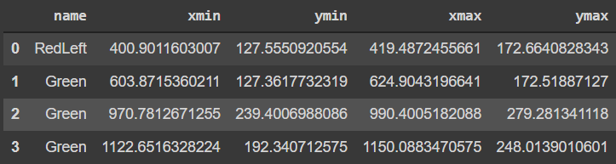
Step 2.
Using all the data we will create a DataFrame that will look something like this.
To do this we will take the use of preprocess_data() function.

Slide 7
Step 3.
Using the DataFrame we will store all the values of xmin, ymin, xmax & ymax in the list format.
We will also store the state of traffic light using the DataFrame.
To achieve this we have used the min_max_values() function.

Slide 8
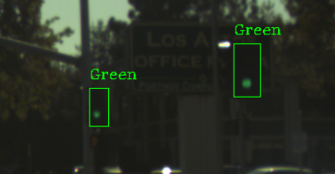
Step 4.
This is the final step where we are taking the xml file path and image path as input and simply using the OpenCV library we are displaying the image which contain
State of the light as text, that can be green,red,yellow or off as well.
A rectangular box around the light.

Slide 9
Second Way to do Task
Using Faster R-CNN

Slide 10
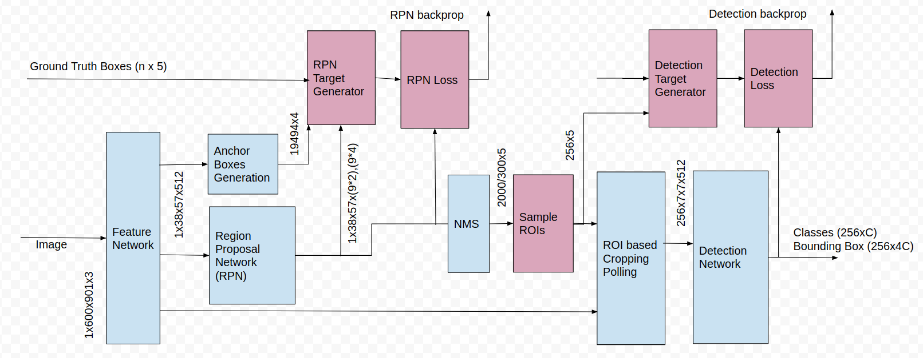
Architecture

Slide 11
Steps
In this all the preprocessing is done to get the DataFrame and all sort of things
After that I’ve make the dataset proper for the model
We have used Faster R-CNN pretrained model.

Slide 12
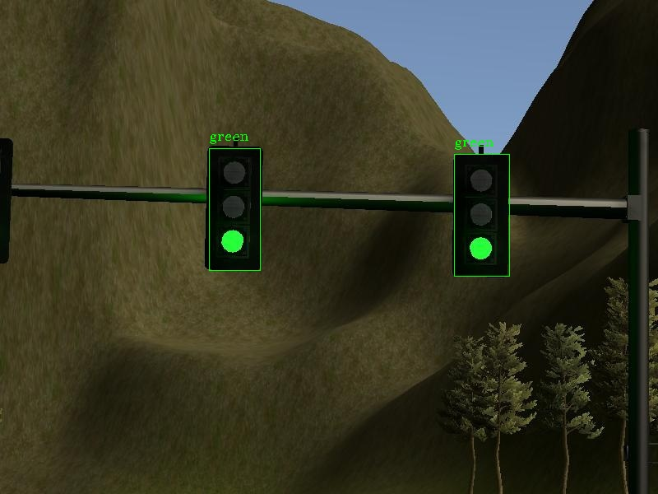
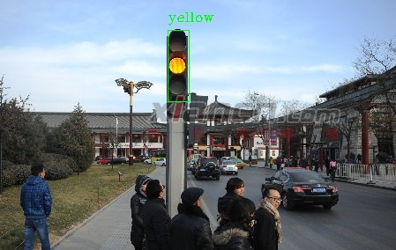
Some Outputs

Slide 13
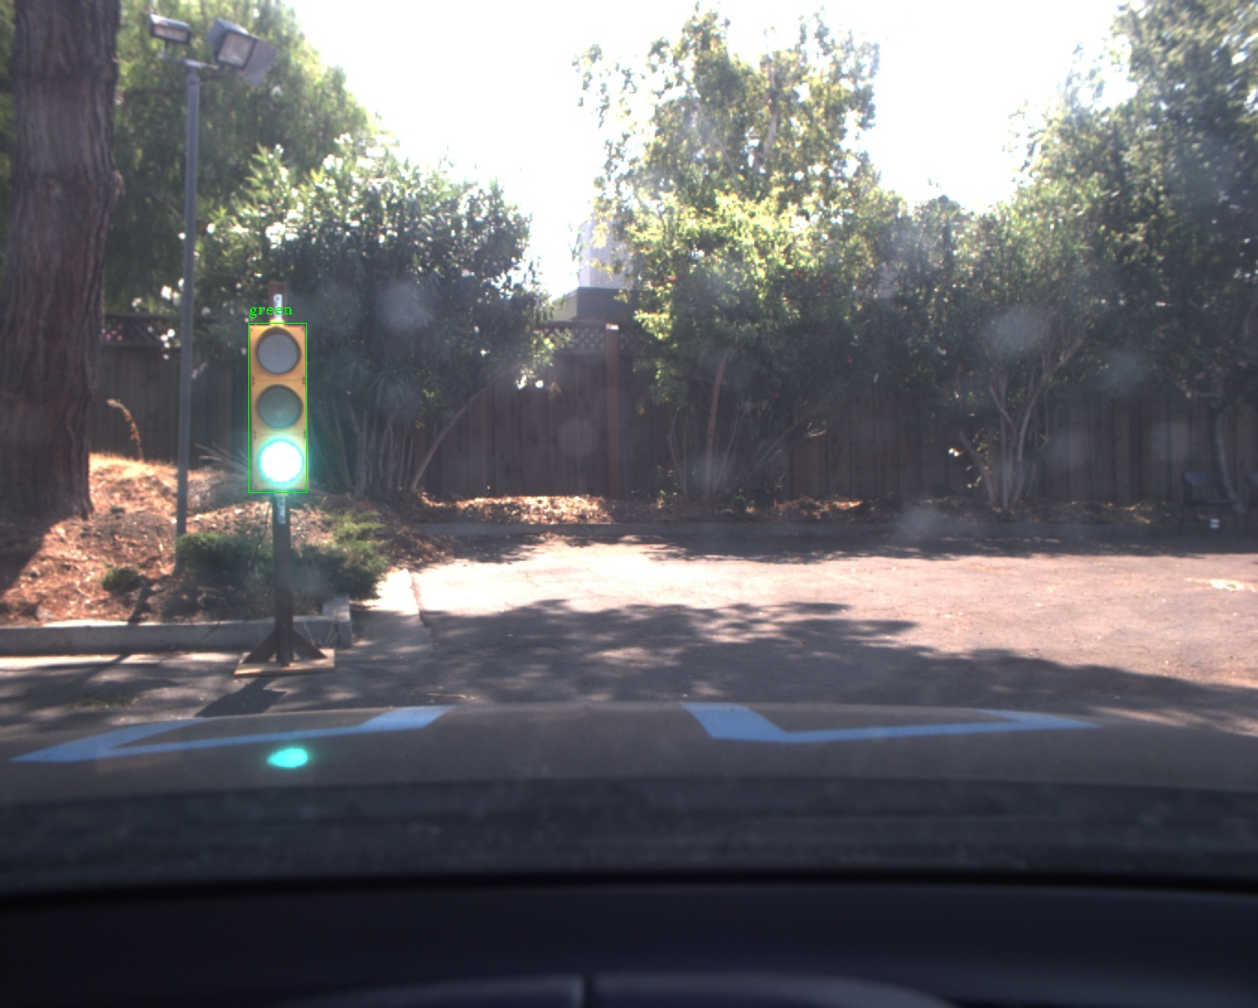
Some Outputs

Slide 14
Thank You

